Slide 1
Aqueous Rare Earth Elements, Concentration, and Stable Isotopes in Deep Basin Brines, Wyoming
Charles Nye¹ Scott Quillinan¹ Ghanashyam Neupane²³ Travis McLing²³
¹Carbon Management Institute, University of Wyoming
²Idaho National Laboratory
³Center for Advanced Energy Studies
Notes:
REEs at ppt level
INL team members

Slide 2
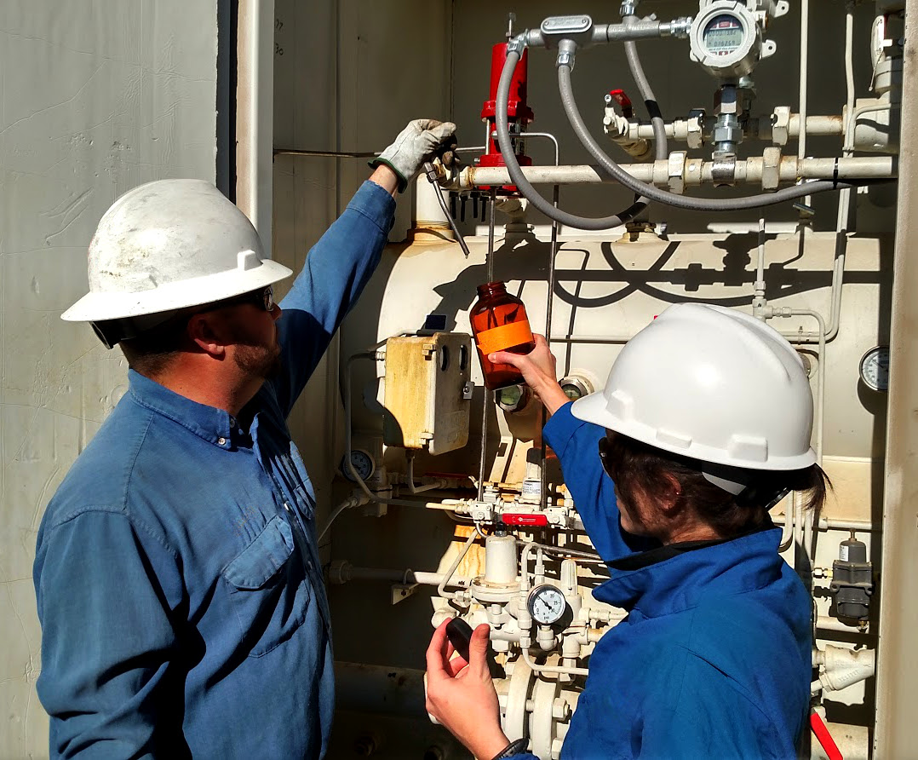
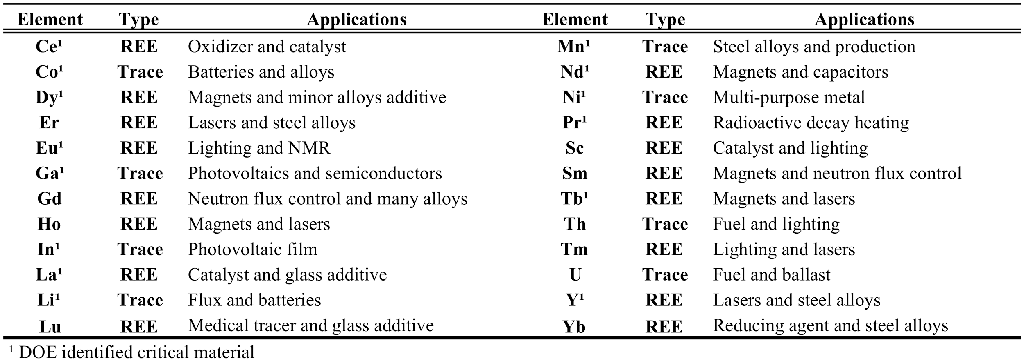
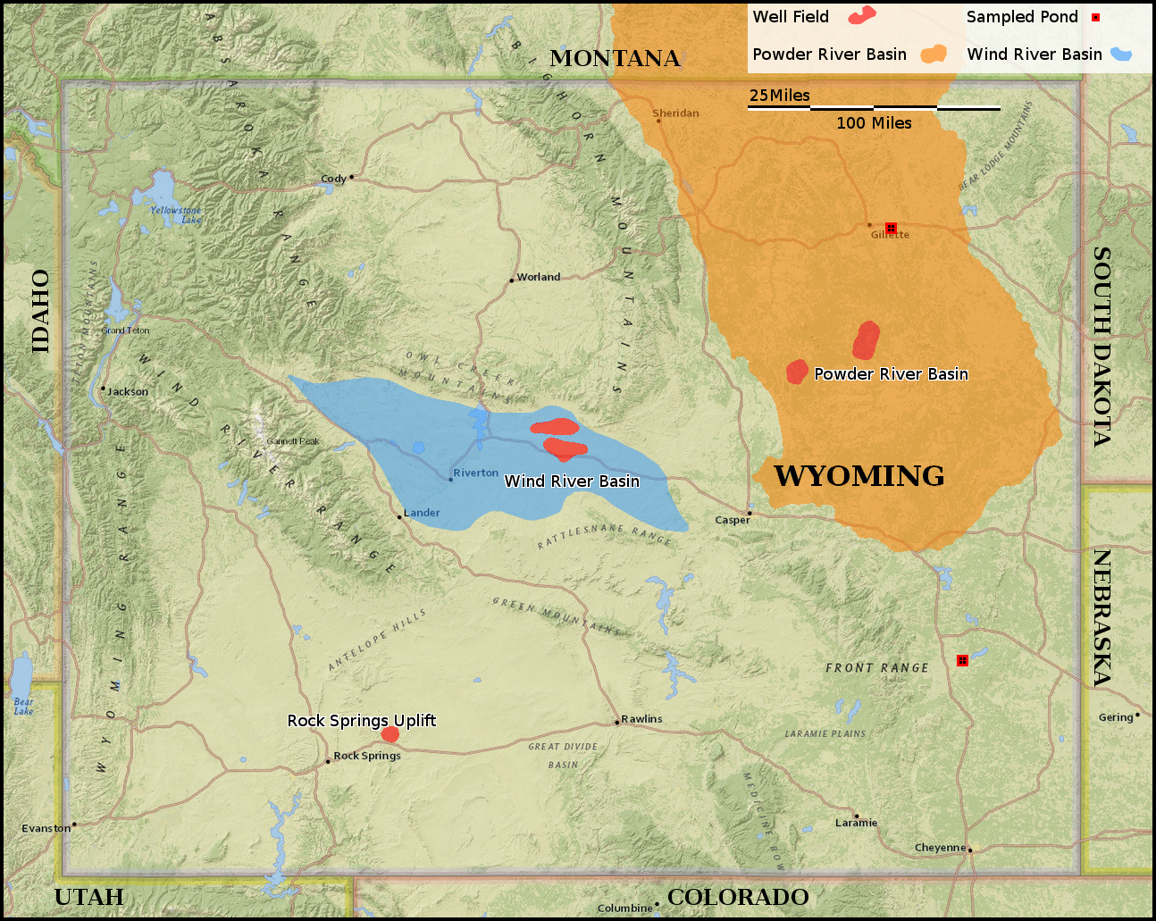
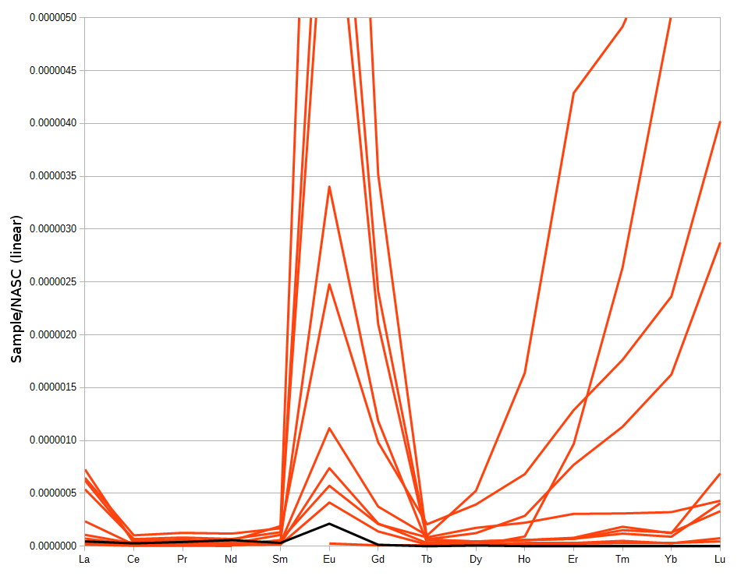
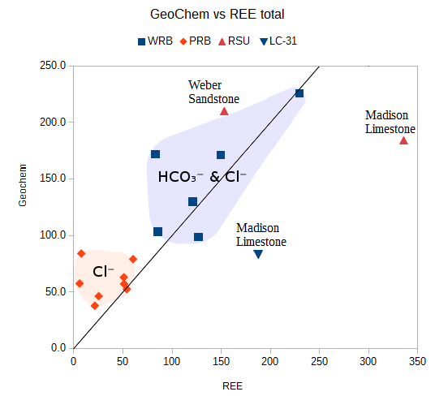
Outline
Why produced waters?
REE importance
Study areas: WRB, PRB, Ponds
Data by Basin & Field
Relationship to possible ligands
Notes:
Talk about isotope and geotherm in the context of study area background

Slide 3
Produced waters are a solution
High Volume, Pre-developed, Hot, and Saline
West needs H₂O
Aqueous mining turns salinity into a resource
Notes:
They are distinct for their high temperatures and salt content.
Volumes large and infrastructure is in place (currently unused)
Total volume 2 billion barrels per year

Slide 4
REE Importance
Needed for current technology economy
Past Water-Rock interactions
Offer tracing opportunity
Sources and authigenic tracking
Notes:
Adequate though sub-optimal substitutes exist for everything I’ve looked at. But these are fairly ‘special’
elements of interest
many REEs in red

Slide 5
REE Importance
Needed for current technology economy
Past Water-Rock interactions
Offer tracing opportunity
Sources and authigenic tracking

Slide 6
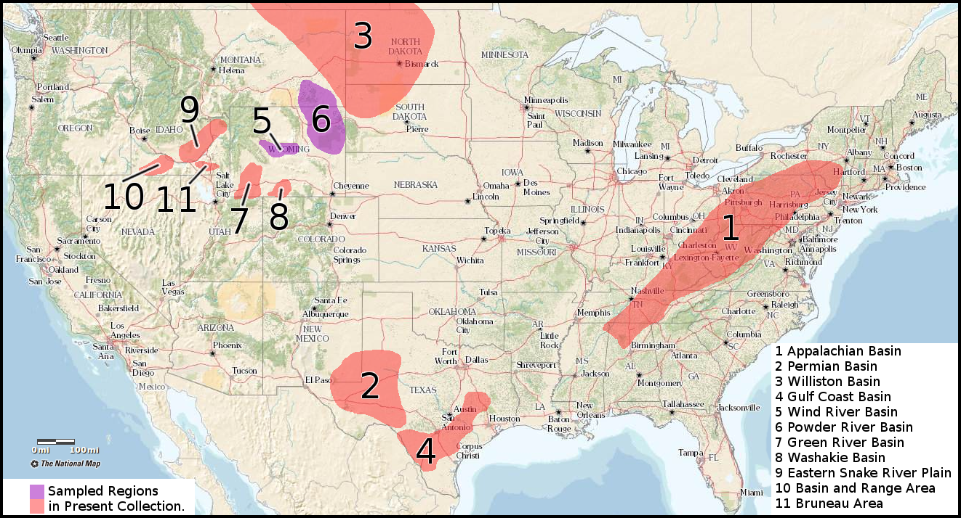
Ongoing REE Work
N ≈ 150
Notes:
Basins at completion
today shown in purple

Slide 7
Study Area for this talk
N = 28
Wind River Basin
Powder River Basin
Power Stations
Notes:
Coloring continuous
Blue Orange Green

Slide 8
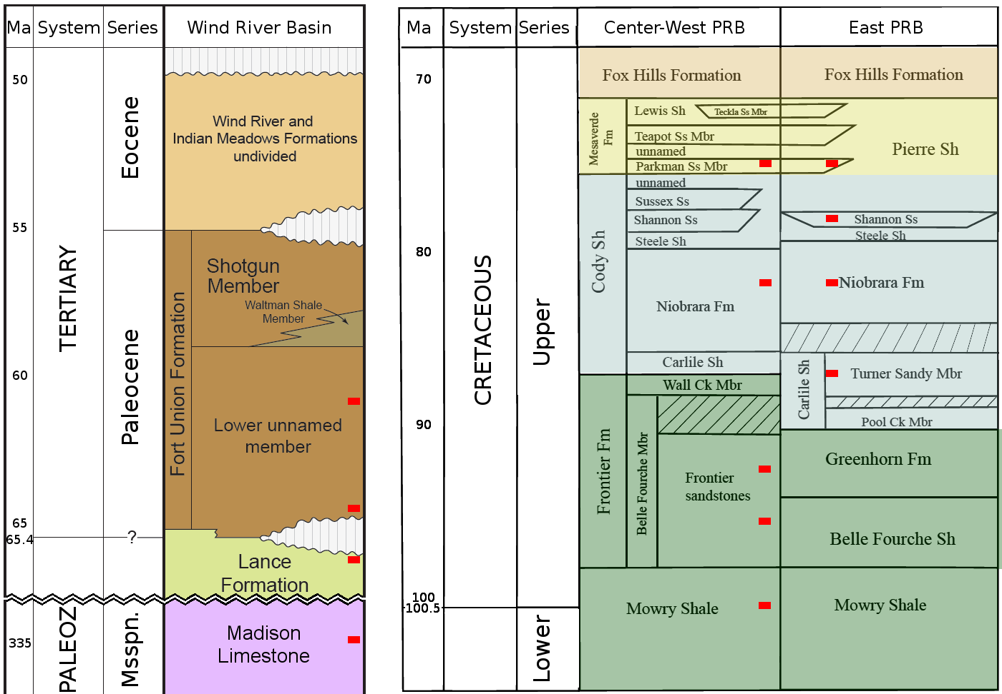
Strata
WRB:
Young-
Very Old
Shallow-
Deep
PRB:
East-
West
Notes:
WRB: 250 million year
15 thousand feet
PRB: 30 miles apart

Slide 9
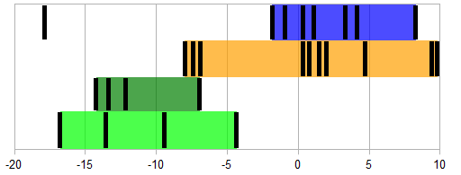
Isotopes: DIC δC¹³
None below -20
Many typical -15 to -5
Some microbial above +2
Ambient
Groundwater
δC¹³
Microbial
Enrichment
Notes:
We see many waters with typical carbon isotope ratios. There’s also 6 that almost cirtainly are involved in microbial processes. The middle ~7 may or may not have bacterial involvement, or could result from interaction with carbonate rocks.

Slide 10
Isotopes: DIC δC¹³
WRB
Indistinct Madison vs Fort Union – Lance
Distinct Treatment
Fort Union - Lance
Madison
Treated Water
Ambient
Groundwater
δC¹³
Microbial
Enrichment
Notes:
Although the Madison and Fort Union overlap isotopically, the treated water is distinct.

Slide 11
Isotopes: DIC δC¹³
PRB
Young Sandstones:P-S
Old Sandstones: T-F
Shales: N-M
Parkman
Shannon
Turner
Frontier
Niobrara
Mowry
Ambient
Groundwater
δC¹³
Microbial
Enrichment
Notes:
Clear grouping by formation. Even between fields.

Slide 12
Isotopes: DIC δC¹³
Power Stations
Same range
Northern Exit becomes more negative: organics?
Southern Exit becomes less negative: microbes?
Northern
Ambient
Groundwater
δC¹³
Microbial
Enrichment
Southern
Notes:
Northern: Fly ash truck and middle ponds - Exit
Southern: Exit – Middle - E.Evap - Evap

Slide 13
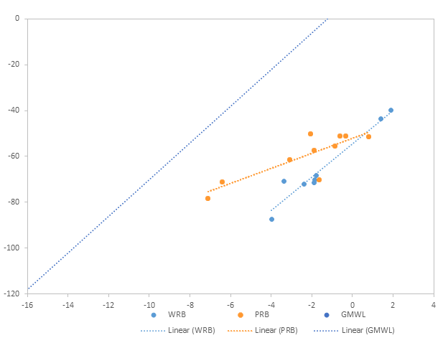
Isotopes: δD, δO¹⁸
Right of GMWL
δO¹⁸ isotopes heavy enriched
Prolonged Rxn with Rock
Non-Meteoric water
Notes:
Standard is VSMOW NOT SLAP

Slide 14
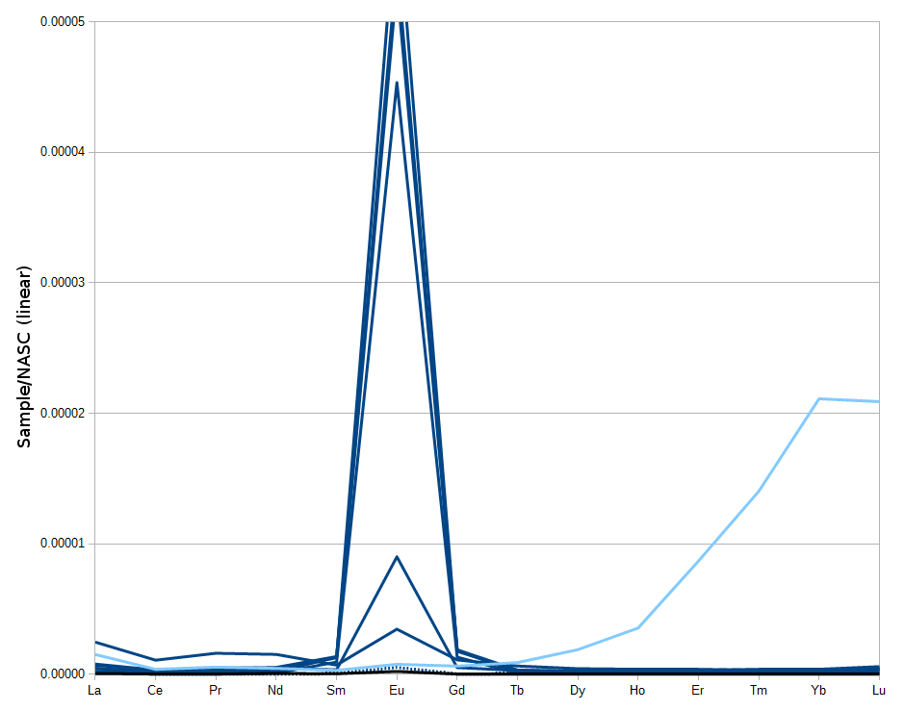
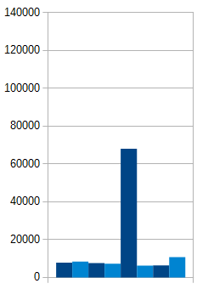
Basin REE
WRB:
175°C & 215°C
TDS
ppm majors
USDW
Notes:
Temperatures are typically ~230°F (110°C) at 5,500ft (1,600m) but can reach ~350°F (175°C) at that depth. The deeper Madison waters exceed 420°F (215°C) At 24,000ft (7,300m)

Slide 15
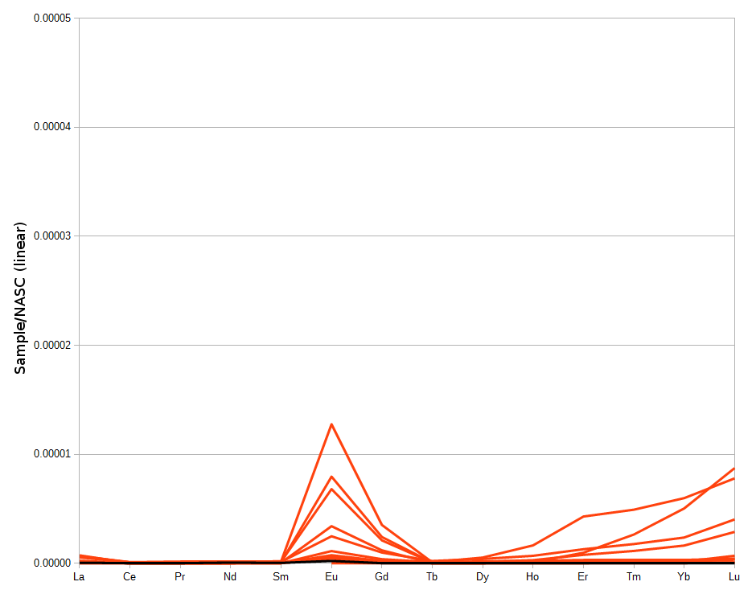
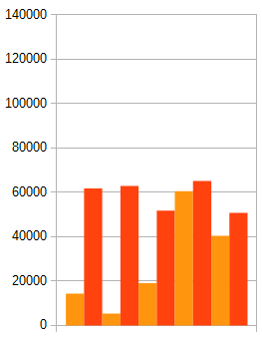
Basin REE
PRB:
115°C
TDS
ppm majors
USDW
Notes:
Temperatures are 230°F (110°C) at 10,000ft (3,000m) in the Turner and 240°F (115°C) at 13,500ft (4,100m) in the Niobrara.
Colder water, lower REEs
More volume, higher Gd and occasional HREEs

Slide 16
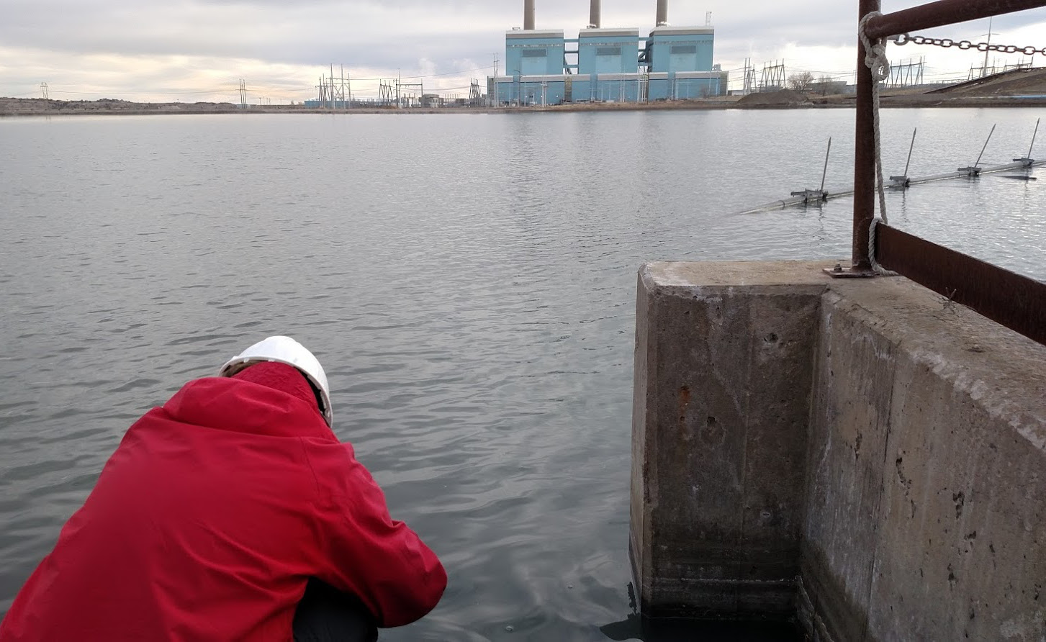
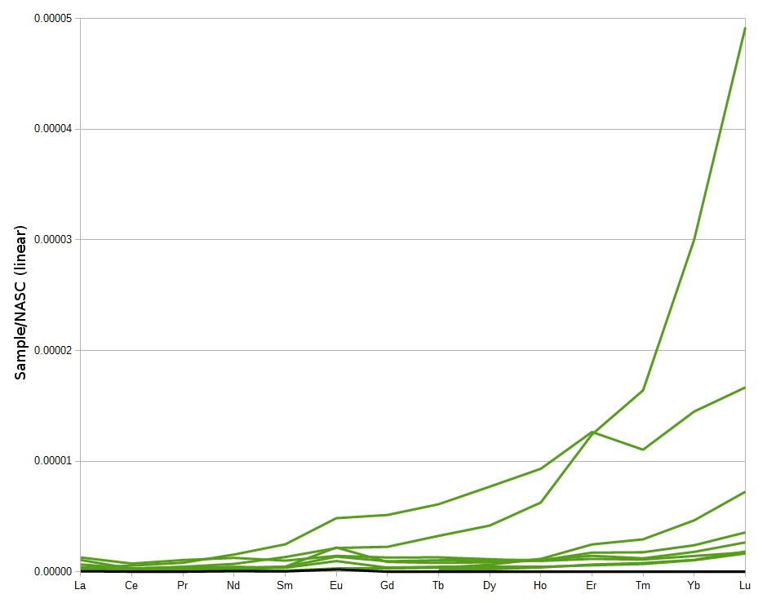
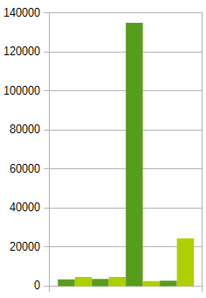
Basin REE
Ash-Ponds:
1270→300→20°C
TDS
ppm majors
Notes:
The samples closest to the power station outlets are the high ones, the multi-year evaporation ponds actually have less
The burner is 2,200°F-2,500°F but the ash is well under 500°F by the time it hits the water

Slide 17
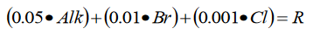
Ligands
Migdisov et al 2016
ppm of:
Cl⁻ Br⁻ HCO₃⁻
ppt of:
total REE
Notes:
The three groups I’ve highlighted for water type also align with depositional environment Clastic marine, Clastic continental, and Carbonates. This is a reason to look at the rocks.
This doesn’t work for the power stations, possibly because of their sulfate content.
Should be taken into milli-equivalents per liter

Slide 18
Conclusions
REE exist in solution and can be measured
δO¹⁸ isotopes show prolonged rock interaction
Geothermal gradient may be high due to coal
Each study area has a unique signature:
Eu - WRB, Gd - PRB, HREE - Ash Ponds
Produced water have local HREE behavior
Total REE in wells may relate to ligands
Role of depositional environment

Slide 19




Acknowledgements
Funding sources:
DOE: EERE
State of Wyoming
Team Members:
Carbon Management
Institute
Notes:
Data seen here INL CMI
Funding
Project Team members

Slide 20
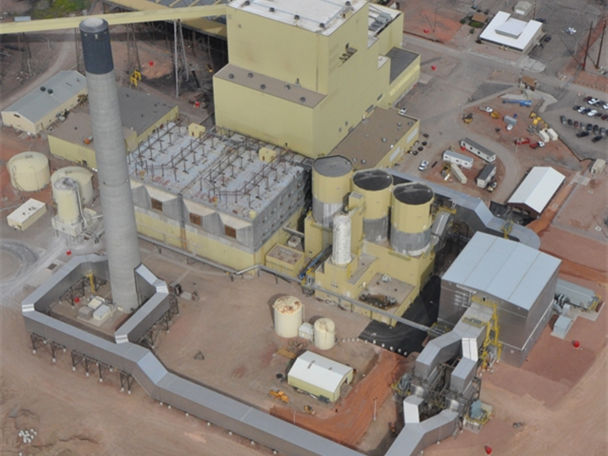
Questions? Comments?
New project
More data collection
Guidance?
Notes:
Guidance, and questions
Thank you

Slide 21
Ref
Chu, Steven.: Critical Materials Strategy, Department of Energy, Office of International Affairs, Washington, DC (2011). Accessed from: https://energy.gov/sites/prod/files/DOE_CMS2011_FINAL_Full.pdf (December, 2016)
Clark, Ian, and Peter Fritz, 1997, Environmental isotopes in hydrogeology: Boca Raton, Fla., Lewis Publishers.
Hatje, Vanessa, Bruland K., and Flegal A. R.“Increases in Anthropogenic Gadolinium Anomalies and Rare Earth Element Concentrations in San Francisco Bay over a 20 Year Record” Environmental Science & Technology 2016 50 (8), 4159-4168 DOI: 10.1021/acs.est.5b04322
McLennan, S. M. (2001), Relationships between the trace element composition of sedimentary rocks and upper continental crust, Geochem. Geophys. Geosyst., 2, 1021, doi:10.1029/2000GC000109.
Migdisov A., A.E. Williams-Jones, J. Brugger, F.A. Caporuscio. (2016) Hydrothermal transport, deposition, and fractionation of the REE: experimental data and thermodynamic calculations. Chemical Geology, 439, pages 13–42. http://dx.doi.org/10.1016/j.chemgeo.2016.06.005

Slide 22
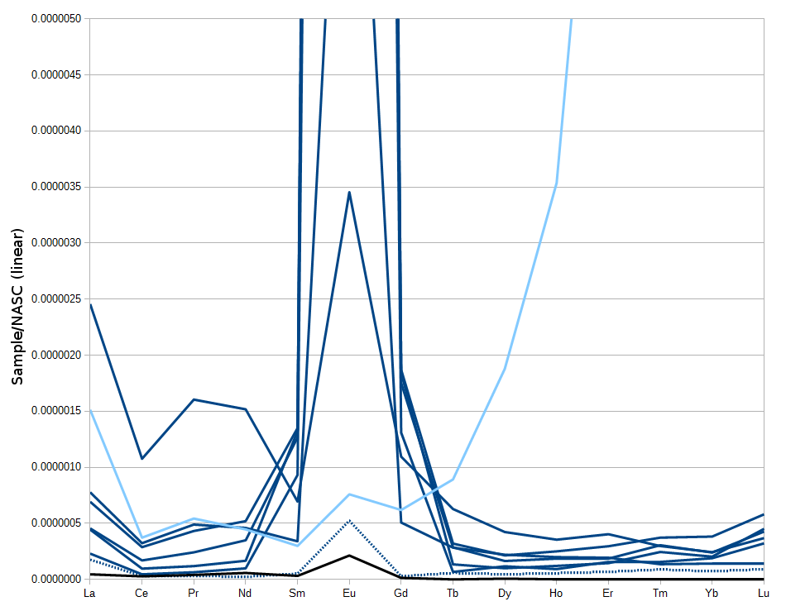
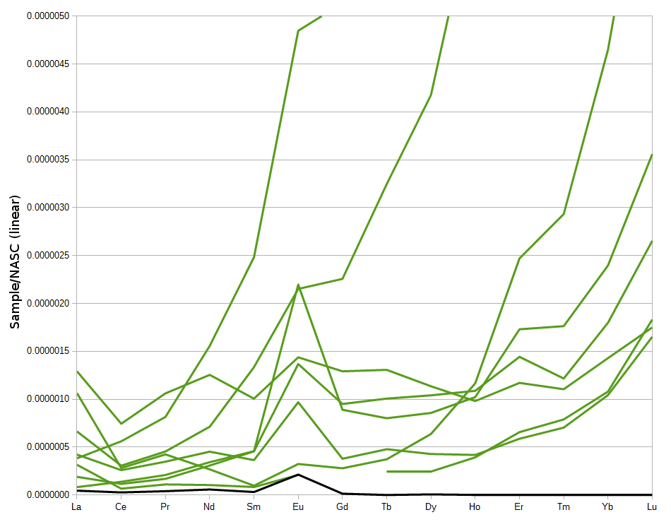
Detection Above Blank
WRB
Power
Stations
PRB
Notes:
Basins by Triad
Fields distinguished Er Yb
Will hold at end of project?
Eu >730% Sm by mass.

Slide 23
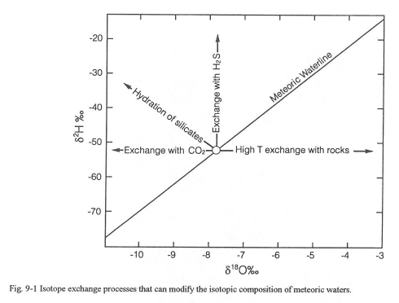
Isotopes from Water-Rock

Slide 24
Isotopes from Water-Rock
Notes:
Ref and Credit Clark and Fritz 1997

Slide 25
Complex Transport
In Power stations the REEs may move with SO4 or OH? (basic)
In Produced waters the REEs may move with Cl or (Bi)Carbonate (neutral acid)

Slide 26
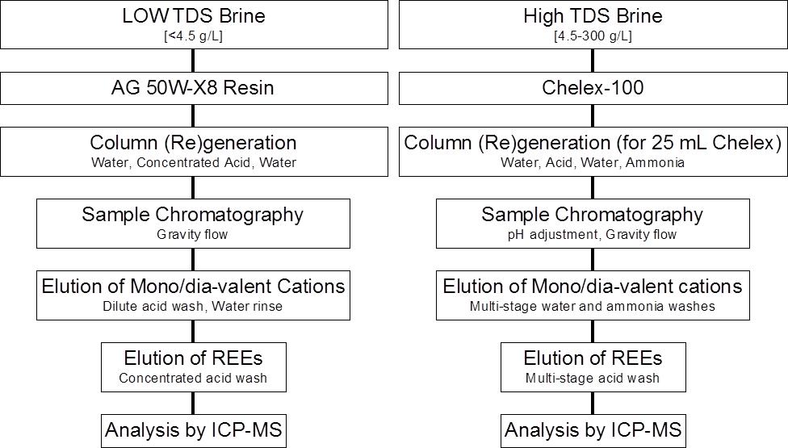

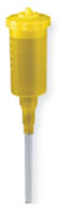
Notes:
Resin, and acid-ammonia
INL essential.

Slide 27
Gd From Ocean to Rock to Water

Slide 28
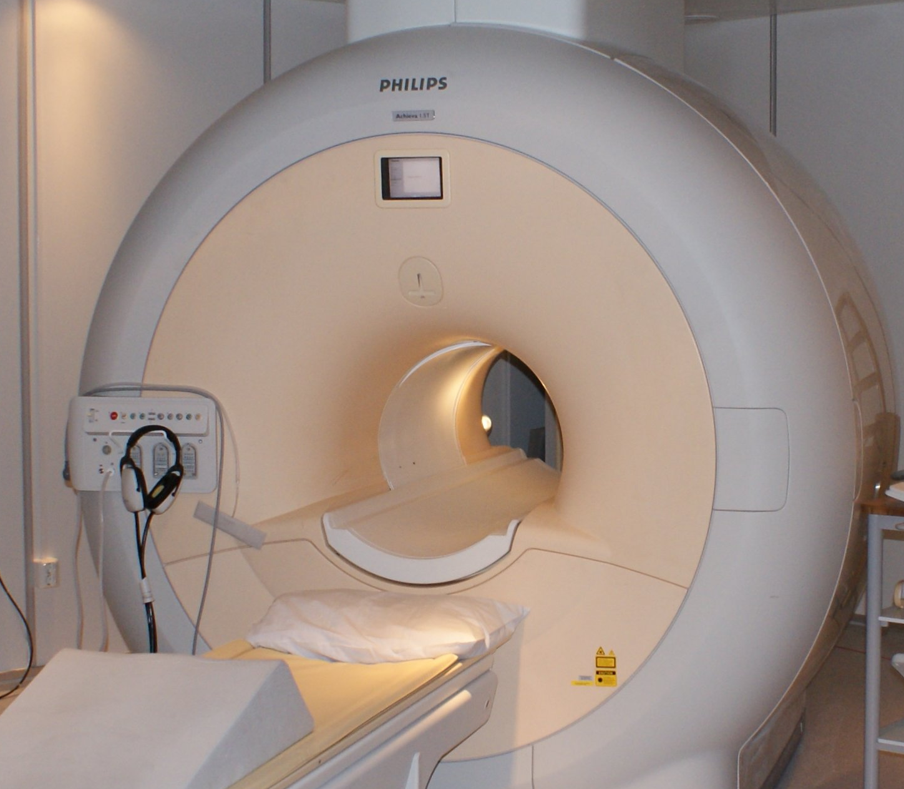
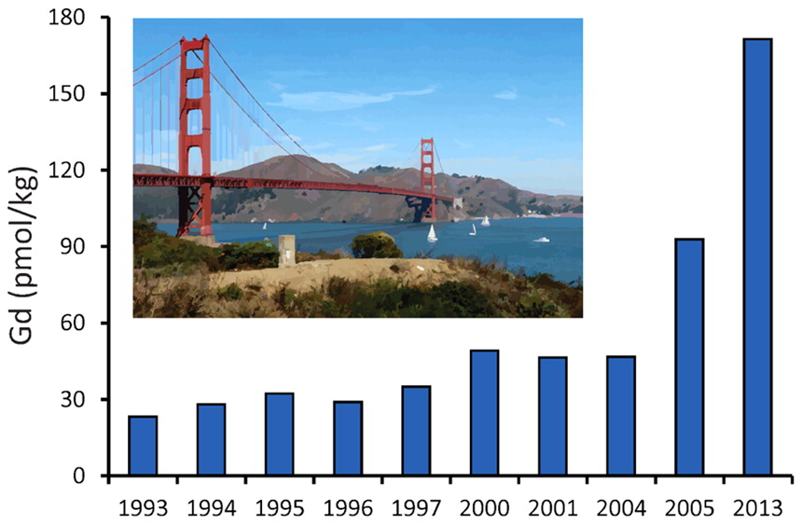
Gd and MRI
Gd in near-city waters can indicate Hospitals with MRIs …. but….
No hospitals 75ma (rock) nor even ~2ka (water)
Recycled frac/mud?

